Slide 1
UPPER SIXTH ARTS
GEOGRAPHY
Lesson 3
Soil Erosion
Notes:
Good morning, class, and welcome to our geography lesson. I am your geography teacher, Mr Kamdem. Today we are starting Lesson 3: Soil Erosion.

Slide 2
CLASS INFO
Class, Chapter and Duration
Class | Upper Sixth Arts
Chapter | Module 7: Understanding and managing contemporary environmental and development issues
Duration | 2 periods (2 × 50 minutes)
Notes:
This lesson is for Upper Sixth Arts. It belongs to Module 7: Understanding and managing contemporary environmental and development issues. We shall need 2 periods to cover it.

Slide 3
IDENTIFICATION
Lesson Identification
Topic | Contemporary Environmental Issues
Sub-topic | Environmental Degradation
Lesson | Lesson 3: Soil Erosion
Notions / Concepts | Soil erosion, splash, sheet, rill and gully erosion, soil conservation, terracing, contour ploughing.
Syllabus focus | Meaning and types; causes; effects; soil conservation methods.
Competence | Learners are able to identify types of soil erosion, explain causes and effects and apply conservation methods.
Notes:
Our topic is Contemporary Environmental Issues, and the sub-topic is Environmental Degradation. The key notions we shall use today are: soil erosion, splash, sheet, rill and gully erosion, soil conservation, terracing, contour ploughing. At the end, you should be able to do this: learners are able to identify types of soil erosion, explain causes and effects and apply conservation methods.

Slide 4

HOMEWORK CORRECTION
Correction of the Homework
Question (Lesson 2: Deforestation and Desertification):
Interview an elder about changes in trees and grass in your area over the years.
Notes:
Before we start the new lesson, let us correct the homework I gave you at the end of Lesson 2: Deforestation and Desertification. The question was: Interview an elder about changes in trees and grass in your area over the years. Take out your exercise books.

Slide 5
HOMEWORK CORRECTION
Correction: Possible Answer
Answers vary. Typical reply: elders say there were more big trees and tall grass in the past; today farms, firewood cutting and bush fires have reduced them, and the dry season feels longer and hotter.
Notes:
Here is a good answer. Answers vary. Typical reply: elders say there were more big trees and tall grass in the past; today farms, firewood cutting and bush fires have reduced them, and the dry season feels longer and hotter. Compare it with your own answer and correct your work in red.

Slide 6
LESSON PLAN
Lesson Plan
Correction of the homework
Objectives and recall
Real-life situation and action to take
Learning activities
Board summary
Evaluation, remediation and homework
Notes:
Here is the plan of our lesson today. First, we shall correct the homework. Then we shall look at the objectives and recall what you already know. After that, we shall study a situation from real life and the action to take, and do the learning activities. Finally, we shall copy the board summary, do the evaluation and the remediation, and I will give you the homework.

Slide 7
OBJECTIVES
Objectives
By the end of this lesson, you should be able to:
Define soil erosion and name its types.
Explain its causes and effects.
Describe soil conservation methods.
Notes:
By the end of this lesson, you should be able to do three things. Number 1: define soil erosion and name its types. Number 2: explain its causes and effects. Number 3: describe soil conservation methods.

Slide 8
PREVIOUS KNOWLEDGE
Previous Knowledge
Rain and wind move soil.
Plants protect the soil.
Notes:
Let us first remember what you already know. Rain and wind move soil. Plants protect the soil. Keep this in mind, because we shall build on it today.

Slide 9
REAL-LIFE SITUATION
Situation in Real Life
On the slopes of the Mandara Mountains, heavy rains wash soil from bare fields. Deep channels appear and harvests fall. Some farmers build stone terraces to stop the damage.
Notes:
Listen carefully to this situation from real life. On the slopes of the Mandara Mountains, heavy rains wash soil from bare fields. Deep channels appear and harvests fall. Some farmers build stone terraces to stop the damage. Think about it, because I am going to ask you some questions.

Slide 10
REAL-LIFE SITUATION
Situation: Question 1
What is the problem in the situation?
Notes:
Question 1: What is the problem in the situation? Think for a moment, then raise your hand to answer.

Slide 11
REAL-LIFE SITUATION
Answer
Soil is washed away from the fields.
Notes:
Good. Soil is washed away from the fields.

Slide 12
REAL-LIFE SITUATION
Situation: Question 2
What are the deep channels called?
Notes:
Question 2: What are the deep channels called? Think for a moment, then raise your hand to answer.

Slide 13
REAL-LIFE SITUATION
Answer
Gullies.
Notes:
Good. Gullies.

Slide 14
REAL-LIFE SITUATION
Situation: Question 3
What solution do some farmers use?
Notes:
Question 3: What solution do some farmers use? Think for a moment, then raise your hand to answer.

Slide 15
REAL-LIFE SITUATION
Possible Answer
Stone terraces.
Notes:
Good. Stone terraces.

Slide 16
ACTION TO TAKE
Action to Take
Protect the soil by keeping it covered and farming along the contours.
Notes:
From this situation, the action we are working towards in this lesson is the following: protect the soil by keeping it covered and farming along the contours.

Slide 17
JUSTIFICATION
Justification of the Lesson
This lesson helps us to protect our soils, which feed us.
Notes:
Why is this lesson important for you? This lesson helps us to protect our soils, which feed us.

Slide 18

1. MEANING
Activity 1
Rain on bare and grassy soil.
Notes:
Activity 1. Look carefully at this animation: rain on bare and grassy soil. Watch the animation to the end; it will play again.

Slide 19
1. MEANING
Activity 1: Question
Why is bare soil eroded faster than grassy soil?
Notes:
Here is the question for Activity 1: Why is bare soil eroded faster than grassy soil? Take one minute to think and write your answer in your rough notebook.

Slide 20
1. MEANING
Activity 1: Answer
Nothing protects it from raindrops or holds it with roots.
Notes:
Let us check the answer together. Nothing protects it from raindrops or holds it with roots.

Slide 21
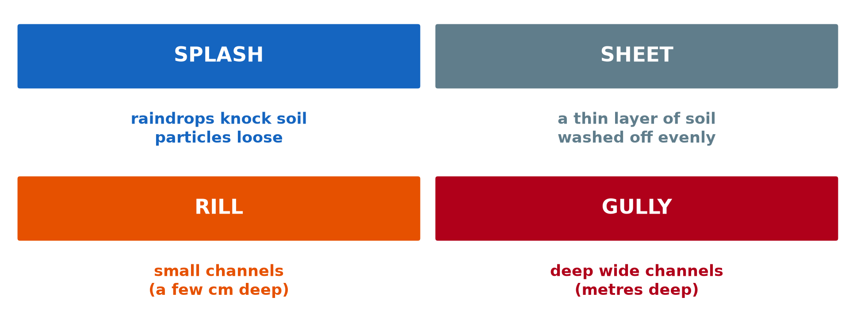
1. TYPES OF SOIL EROSION
Activity 2
Types of soil erosion by water.
Notes:
Activity 2. Look carefully at this diagram: types of soil erosion by water. Observe every detail before I ask the question.

Slide 22
1. TYPES OF SOIL EROSION
Activity 2: Question
Distinguish rill and gully erosion.
Notes:
Here is the question for Activity 2: Distinguish rill and gully erosion. Take one minute to think and write your answer in your rough notebook.

Slide 23
1. TYPES OF SOIL EROSION
Activity 2: Answer
Rills are small shallow channels; gullies are deep, wide channels.
Notes:
Let us check the answer together. Rills are small shallow channels; gullies are deep, wide channels.

Slide 24

2. CAUSES AND EFFECTS
Activity 3
A gully.
Notes:
Activity 3. Look carefully at this picture: a gully. Observe every detail before I ask the question.

Slide 25
2. CAUSES AND EFFECTS
Activity 3: Question
Give two human causes of soil erosion.
Notes:
Here is the question for Activity 3: Give two human causes of soil erosion. Take one minute to think and write your answer in your rough notebook.

Slide 26
2. CAUSES AND EFFECTS
Activity 3: Answer
Deforestation and overgrazing (also bush fires and ploughing down slopes).
Notes:
Let us check the answer together. Deforestation and overgrazing (also bush fires and ploughing down slopes).

Slide 27

3. MECHANICAL METHODS
Activity 4
Terraces on a hillside.
Notes:
Activity 4. Look carefully at this picture: terraces on a hillside. Observe every detail before I ask the question.

Slide 28
3. MECHANICAL METHODS
Activity 4: Question
How do terraces reduce soil erosion?
Notes:
Here is the question for Activity 4: How do terraces reduce soil erosion? Take one minute to think and write your answer in your rough notebook.

Slide 29
3. MECHANICAL METHODS
Activity 4: Answer
They turn slopes into flat steps that slow down running water.
Notes:
Let us check the answer together. They turn slopes into flat steps that slow down running water.

Slide 30
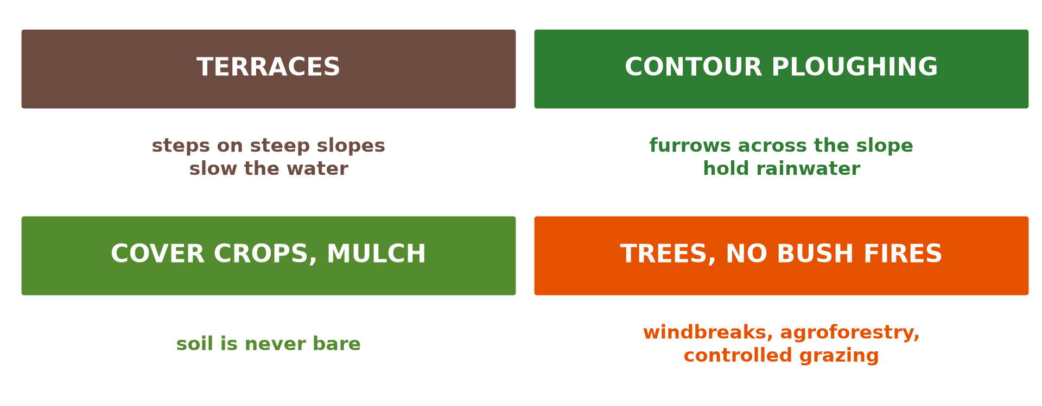
3. BIOLOGICAL METHODS
Activity 5
Soil conservation methods.
Notes:
Activity 5. Look carefully at this diagram: soil conservation methods. Observe every detail before I ask the question.

Slide 31
3. BIOLOGICAL METHODS
Activity 5: Question
Give three other conservation methods.
Notes:
Here is the question for Activity 5: Give three other conservation methods. Take one minute to think and write your answer in your rough notebook.

Slide 32
3. BIOLOGICAL METHODS
Activity 5: Answer
Contour ploughing, cover crops and tree planting.
Notes:
Let us check the answer together. Contour ploughing, cover crops and tree planting.

Slide 33
BOARD SUMMARY
Board Summary
Topic: Contemporary Environmental Issues
Sub-topic: Environmental Degradation
Lesson 3: Soil Erosion
Notes:
Now we are going to copy the board summary. Write the title and the headings neatly in your notebooks. I will give you enough time for each slide, so do not rush.

Slide 34
BOARD SUMMARY
1. Meaning and Types of Soil Erosion
Soil erosion and its types can be defined as follows:
Soil erosion: It is the removal of the top soil by water, wind or people faster than it forms. It is accelerated when the soil is left bare.
Notes:
Let us copy Meaning and Types of Soil Erosion. Soil erosion and its types can be defined as follows. On this slide we have Soil erosion. Write each point on a new line, with the key term first, and explain it in your own words when we revise. When you finish, we go to the next slide.

Slide 35
BOARD SUMMARY
1. Meaning and Types of Soil Erosion (continued)
Water erosion: Splash erosion loosens soil with raindrops, and sheet erosion removes a thin layer evenly. Rill erosion cuts small channels, and gully erosion makes deep channels.
Notes:
We continue with Meaning and Types of Soil Erosion. On this slide we have Water erosion. Write each point on a new line, with the key term first, and explain it in your own words when we revise. When you finish, we go to the next slide.

Slide 36
BOARD SUMMARY
1. Meaning and Types of Soil Erosion (continued)
Wind erosion: It is common in dry areas with bare, loose soil. The wind lifts and carries fine particles far away.
Notes:
We continue with Meaning and Types of Soil Erosion. On this slide we have Wind erosion. Write each point on a new line, with the key term first, and explain it in your own words when we revise.

Slide 37
BOARD SUMMARY
1. Meaning and Types of Soil Erosion
Illustration: types of soil erosion by water
Notes:
Now draw this illustration in your notebook: types of soil erosion by water. Give it a title and label it clearly.

Slide 38
BOARD SUMMARY
2. Causes and Effects of Soil Erosion
Soil erosion has the following causes and effects:
Physical causes: Heavy rain, steep slopes, strong winds and loose soils favour erosion. Long dry seasons leave little plant cover.
Notes:
Let us copy Causes and Effects of Soil Erosion. Soil erosion has the following causes and effects. On this slide we have Physical causes. Write each point on a new line, with the key term first, and explain it in your own words when we revise. When you finish, we go to the next slide.

Slide 39
BOARD SUMMARY
2. Causes and Effects of Soil Erosion (continued)
Human causes: Deforestation, overgrazing, bush fires and ploughing up and down slopes expose the soil. Road building and mining also remove plant cover.
Notes:
We continue with Causes and Effects of Soil Erosion. On this slide we have Human causes. Write each point on a new line, with the key term first, and explain it in your own words when we revise. When you finish, we go to the next slide.

Slide 40
BOARD SUMMARY
2. Causes and Effects of Soil Erosion (continued)
Effects: Soil fertility and crop yields fall, and gullies destroy farms and roads. Eroded soil silts rivers and dams and causes floods.
Notes:
We continue with Causes and Effects of Soil Erosion. On this slide we have Effects. Write each point on a new line, with the key term first, and explain it in your own words when we revise.

Slide 41
BOARD SUMMARY
3. Soil Conservation Methods
Soil is conserved by the following methods:
Mechanical methods: Terraces, stone lines and contour ploughing slow water on slopes. Gullies can be blocked with check dams.
Notes:
Let us copy Soil Conservation Methods. Soil is conserved by the following methods. On this slide we have Mechanical methods. Write each point on a new line, with the key term first, and explain it in your own words when we revise. When you finish, we go to the next slide.

Slide 42
BOARD SUMMARY
3. Soil Conservation Methods (continued)
Biological methods: Cover crops, mulching, agroforestry and grass strips protect the soil. Crop rotation and manure keep it fertile.
Management methods: Controlled grazing and the ban on bush fires keep plant cover. Windbreaks of trees reduce wind erosion.
Notes:
We continue with Soil Conservation Methods. On this slide we have Biological methods and Management methods. Write each point on a new line, with the key term first, and explain it in your own words when we revise.

Slide 43
BOARD SUMMARY
3. Soil Conservation Methods
Illustration: soil conservation methods
Notes:
Now draw this illustration in your notebook: soil conservation methods. Give it a title and label it clearly.

Slide 44
FORMATIVE EVALUATION
Evaluation 1
Name four types of water erosion.
Notes:
Now let us check what you have understood. Question 1: Name four types of water erosion. Answer in your exercise book.

Slide 45
FORMATIVE EVALUATION
Expected Answer
Splash, sheet, rill and gully.
Notes:
The expected answer is: splash, sheet, rill and gully. If you got it right, well done.

Slide 46
FORMATIVE EVALUATION
Evaluation 2
Give two mechanical and two biological conservation methods.
Notes:
Now let us check what you have understood. Question 2: Give two mechanical and two biological conservation methods. Answer in your exercise book.

Slide 47
FORMATIVE EVALUATION
Expected Answer
Mechanical: terraces, contour ploughing. Biological: cover crops, trees.
Notes:
The expected answer is: mechanical: terraces, contour ploughing. Biological: cover crops, trees. If you got it right, well done.

Slide 48
REMEDIATION
Remediation
Fill in the blanks:
Deep channels cut by water are ______.
Steps built on slopes are ______.
Ploughing across the slope is ______ ploughing.
Notes:
For those who need more practice, fill in the blanks in your exercise book. The answers are: number 1, gullies; number 2, terraces; number 3, contour.

Slide 49
HOMEWORK
Homework
Observe a slope near your home and suggest two ways to protect its soil.
Notes:
For your homework: Observe a slope near your home and suggest two ways to protect its soil. We shall correct it at the beginning of our next lesson.

Slide 50
NEXT LESSON
Next Lesson
Our next lesson will be on:
Lesson 4: Climatic Change
Notes:
Our next lesson will be on Lesson 4: Climatic Change. Thank you for your attention, and see you next time.

Slide 51
BILINGUAL GAME
Bilingual Game (Jeu Bilingue)
English | Français
Soil erosion | L'érosion des sols
Gully | Le ravin
Terrace | La terrasse
Slope | La pente
Mulch | Le paillage
Topsoil | La couche arable
Notes:
Let us play the bilingual game. I say a word in English, and you give me the French word. Then we do the reverse.

Slide 52
LOGBOOK
Official Logbook (1/2)
Module / Topic | Contemporary Environmental Issues
Lesson Title | Lesson 3: Soil Erosion
Expected Learning Outcomes | Define soil erosion and name its types. Explain its causes and effects. Describe soil conservation methods.
Competence | Learners are able to identify types of soil erosion, explain causes and effects and apply conservation methods.
Notes:
I record this information in the official logbook of the class after the lesson.

Slide 53
LOGBOOK
Official Logbook (2/2)
Matter Taught | Meaning and Types of Soil Erosion; Causes and Effects of Soil Erosion; Soil Conservation Methods.
Evaluation | Formative evaluation and remediation exercise.
Homework | Observe a slope near your home and suggest two ways to protect its soil.
Enrolment / Present / Absent | ____ / ____ / ____
Achievement | To be completed after the lesson.
Notes:
I complete the second page of the logbook: the matter taught, the evaluation, the homework and the attendance.

Slide 54
TEACHER'S NOTE
Teacher's Note
Timing: Homework correction, plan, objectives 8 min | Recall, situation, action 10 min | 5 activities 30 min | Board summary (copying) 30 min | Evaluation, remediation 10 min | Homework, next lesson 5 min | Logbook 7 min
Activity 1 is an animation (GIF): it plays automatically in slide-show mode.
Without the projector (Activity 1): compare two plots.
Without the projector (Activity 2): describe each type.
Without the projector (Activity 3): find gullies near school.
Without the projector (Activity 4): draw a terrace.
Without the projector (Activity 5): list methods used locally.
Notes:
This slide is for me, the teacher: it gives the timing of the lesson and what to do if the projector is not available.

Slide 55
REFERENCES
References
National Geography Syllabus, MINESEC/IGE/IP-SS, 2019 — Module 7 (Environment and Development).
Photo, Activity 3: “Soil erosion in the central Mexican Highlands” by CIMMYT, CC BY-NC-SA 2.0, via Flickr (https://www.flickr.com/photos/44760652@N05/6244930288)
Photo, Activity 4: “Terraced Hillside” by AdamCohn, CC BY-NC-ND 2.0, via Flickr (https://www.flickr.com/photos/96142515@N00/6311042523)
Diagrams and animations: drawn for this lesson (Geography Department).
Notes:
These are the references and picture credits used to prepare this lesson.

